Slide 1
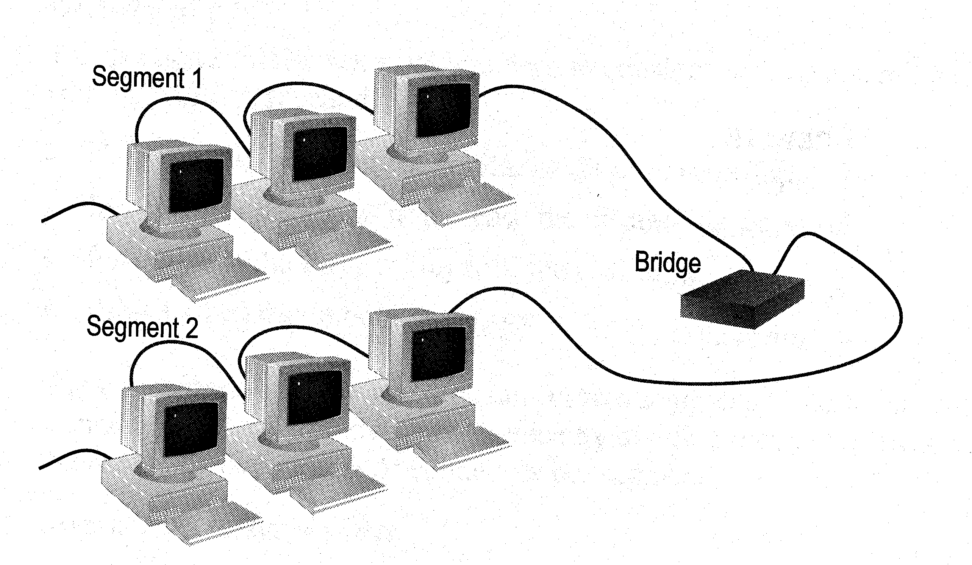
NETWORK DEVICES AND FUNCTIONALITES
8. Network Devices
8. Network Devices

Slide 2
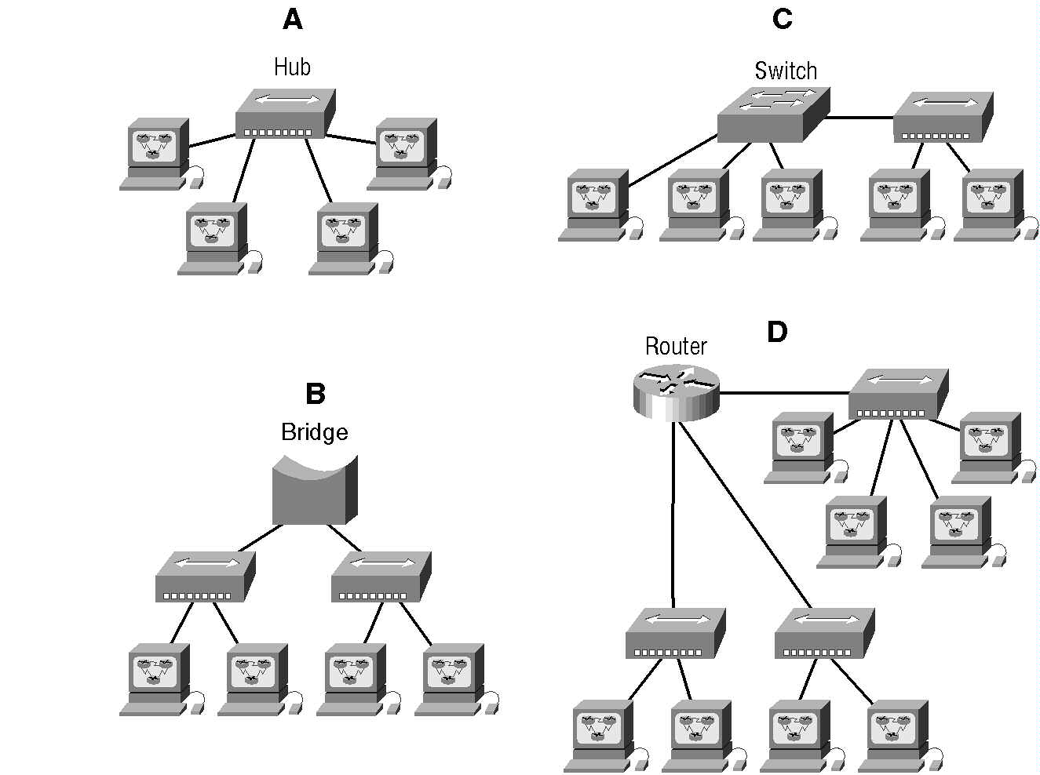
Identify collision and broadcast domains for each case
IST 228\Ch1\Internetworking

Slide 3
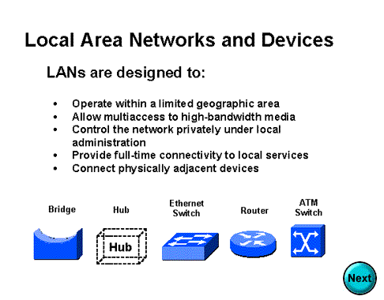

Slide 4
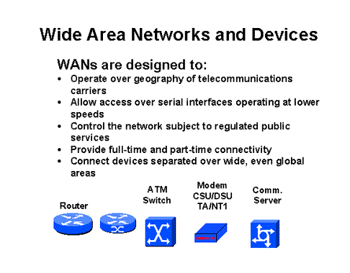

Slide 5

ENG224
INFORMATION TECHNOLOGY – Part I
8. Network Devices
Functions of network devices
Separating (connecting) networks or expanding network
  e.g. repeaters, hubs, bridges, routers, brouters, switches, gateways
Remote access
  e.g. 56K Modems and ADSL modems

Slide 6
ENG224
INFORMATION TECHNOLOGY – Part I
8. Network Devices
A. Expanding Network
Networks cannot be made larger by simply adding new computers and more cables
  Less efficient !!
Can install components to
  segment (divide) large LAN to form smaller LANs
  connect LANs
Required components
  Repeaters, bridges, routers, brouters, switches or gateways

Slide 7
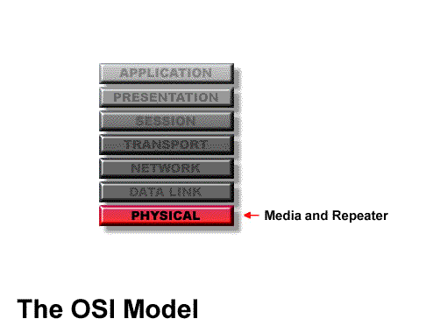
Location of Repeater

Slide 8
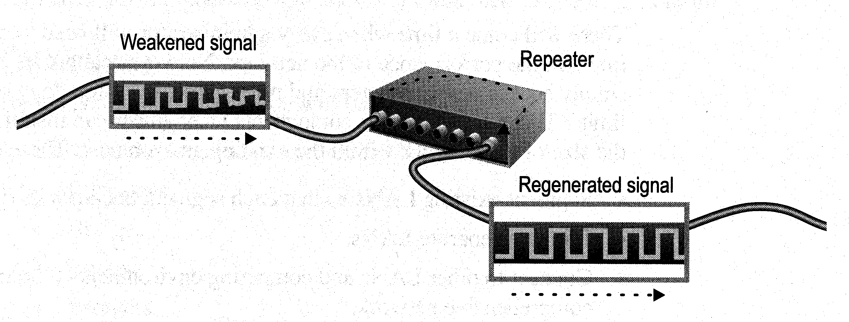
ENG224
INFORMATION TECHNOLOGY – Part I
8. Network Devices
a. Repeaters and Hubs
Repeaters or hubs work at the OSI physical layer to regenerate the network’s signal and resend them to other segments
Primitive hub can be viewed as a multiport repeater
  It regenerates data and broadcasts them to all ports
Hub

Slide 9
Hub
Multi-port repeaters are often called hubs. Hubs are very common internetworking devices. Generally speaking, the term hub is used instead of repeater when referring to the device that serves as the center of a star topology network.

Slide 10
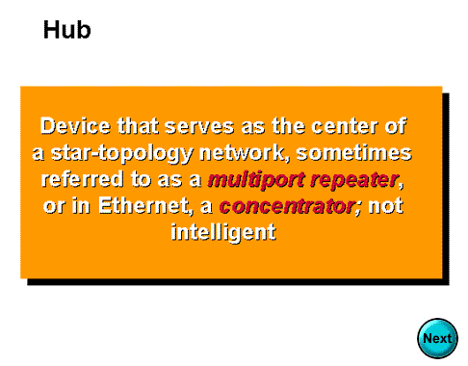

Slide 11
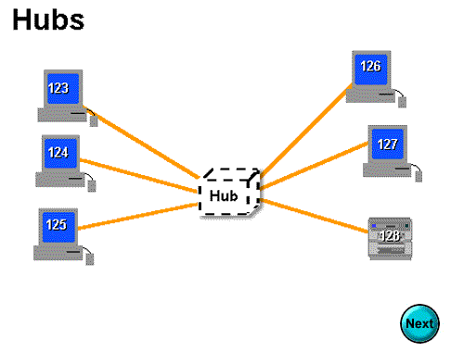

Slide 12
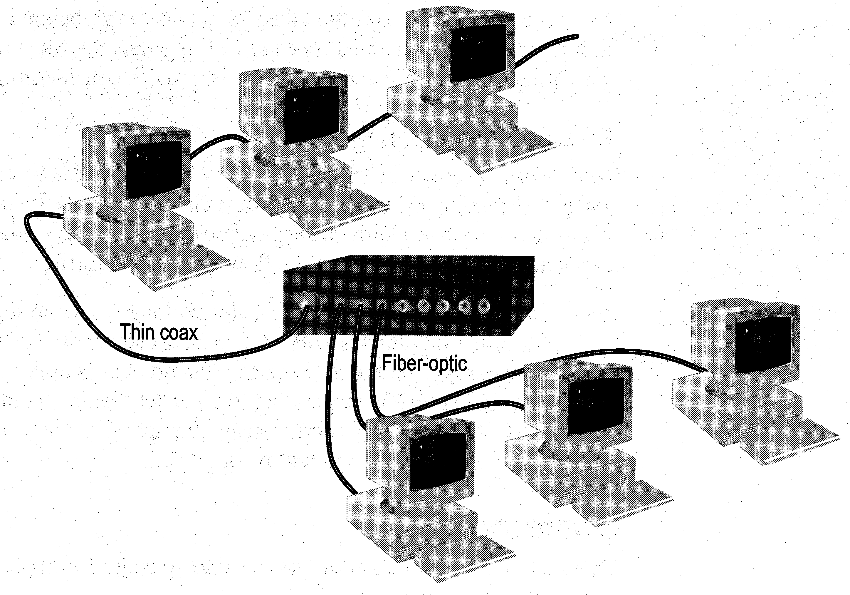
ENG224
INFORMATION TECHNOLOGY – Part I
8. Network Devices
Limitations and Features
Cannot link unlike segments
Cannot join segments with different access methods (e.g. CSMA/CD and token passing)
Do not isolate and filter packets
Can connect different types of media
The most economic way of expanding networks

Slide 13
ENG224
INFORMATION TECHNOLOGY – Part I
8. Network Devices
b. Bridges
Has one input and one output
Used to isolate network traffic and computers
Has the intelligent to examine incoming packet source and destination addresses
But cannot interpret higher-level information
Hence cannot filter packet according to its protocol

Slide 14
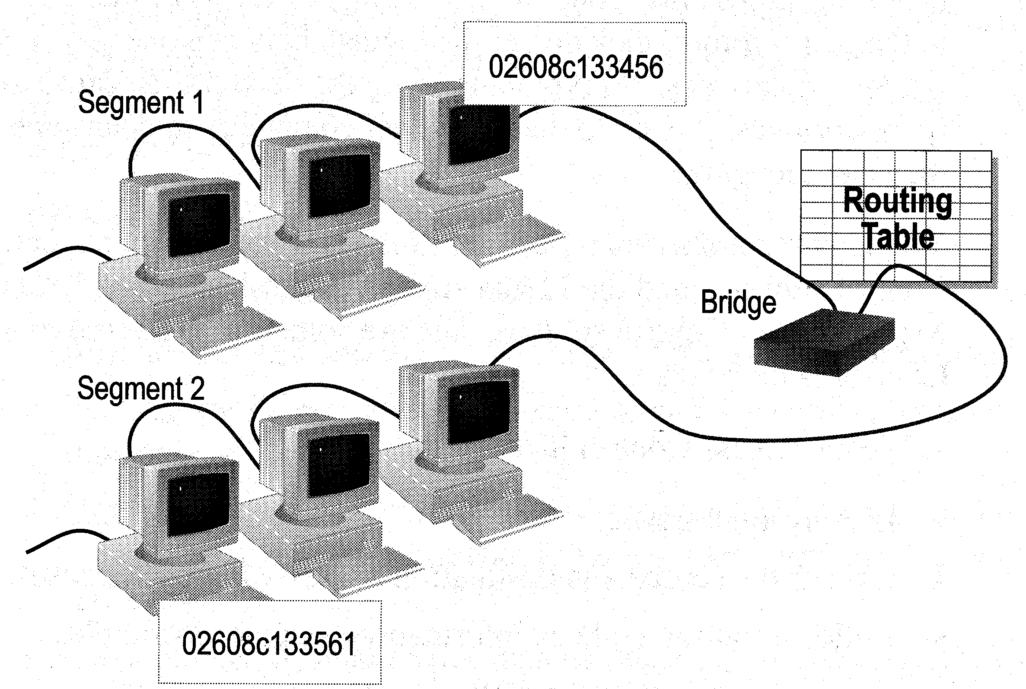
ENG224
INFORMATION TECHNOLOGY – Part I
8. Network Devices
How Bridges Work
Bridges work at the Media Access Control Sub-layer of the OSI model
  Routing table is built to record the segment no. of address
  If destination address is in the same segment as the source address, stop transmit
  Otherwise, forward to the other segment

Slide 15
ENG224
INFORMATION TECHNOLOGY – Part I
8. Network Devices
Creating a Switching Table
Based on the addresses of the sending computers
New addresses are added if they are not in the table
Add02
S 02 D 01
Switching Table
Seg 1 Seg 2
Add01
01
Stop
02
Add03
S 01 D 02

Slide 16
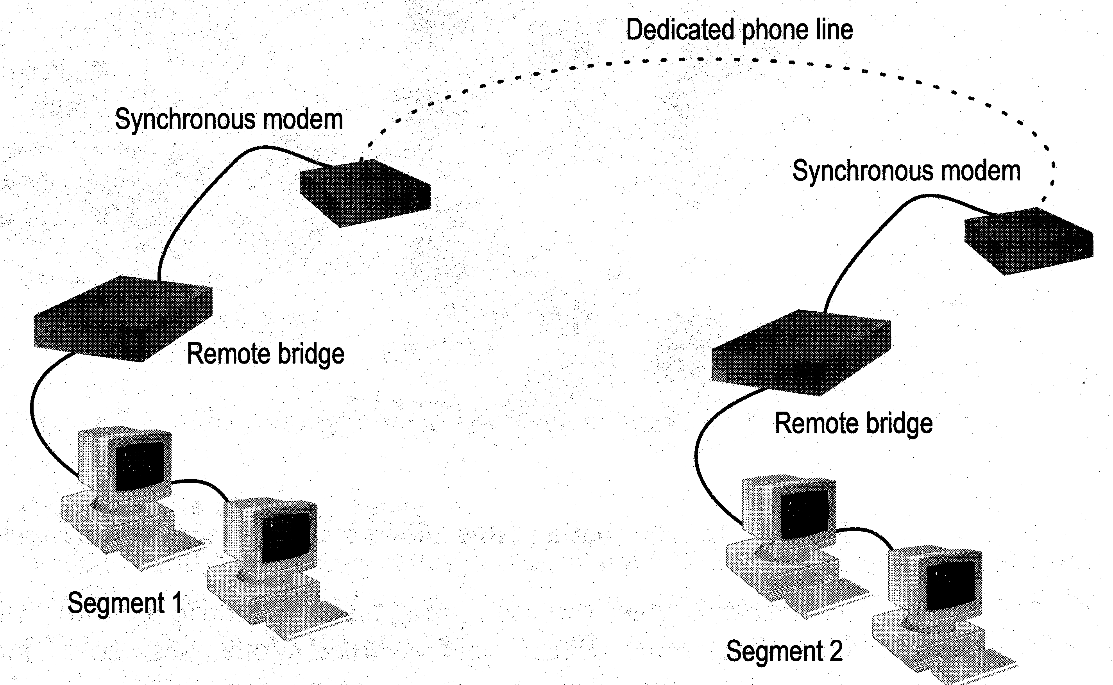
ENG224
INFORMATION TECHNOLOGY – Part I
8. Network Devices
Remote Bridges
Bridges are often used in large networks that have widely dispersed segments
Remote bridges can be used to connect remote segments via data-grade telephone line

Slide 17
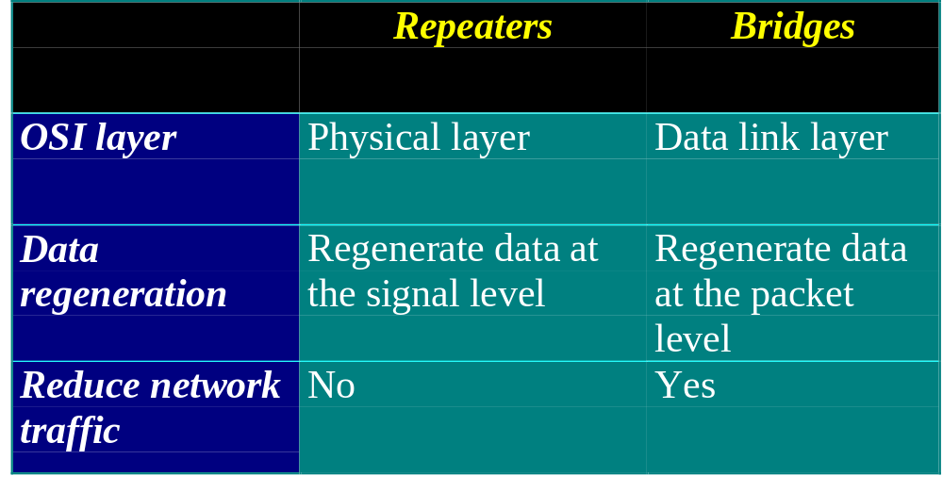
ENG224
INFORMATION TECHNOLOGY – Part I
8. Network Devices
Differences Between Bridges and Repeaters

Slide 18
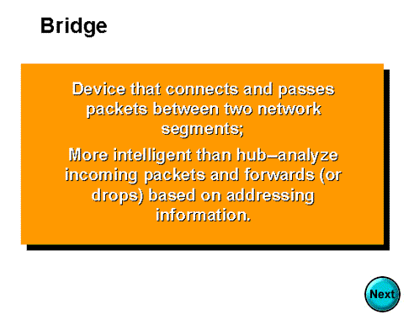

Slide 19
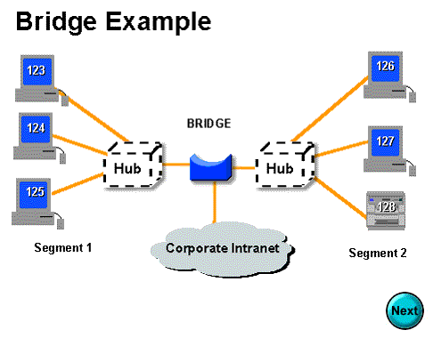

Slide 20
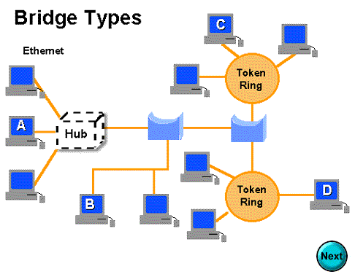

Slide 21
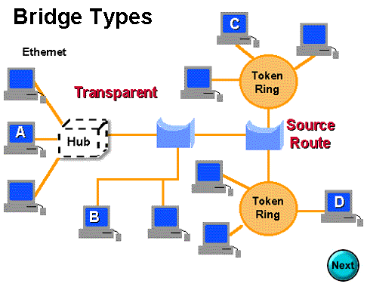

Slide 22
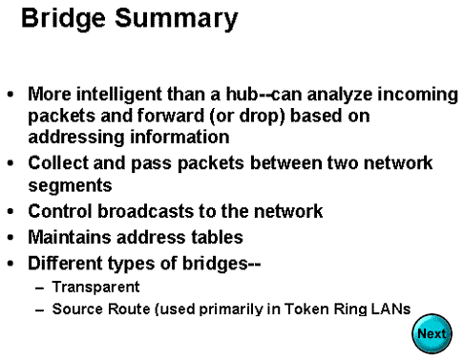

Slide 23
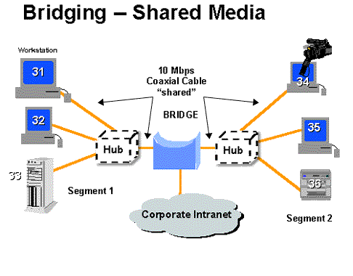

Slide 24
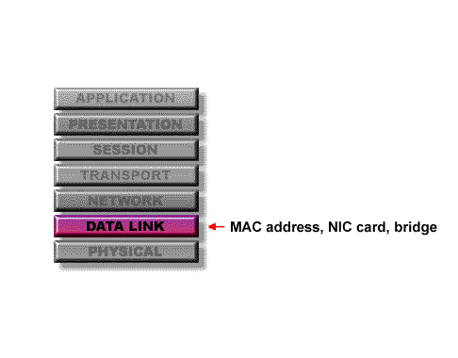
At what layer of the OSI model do bridges operate?
Because bridges operate at the data link layer, layer 2, they are not required to examine upper-layer information.

Slide 25
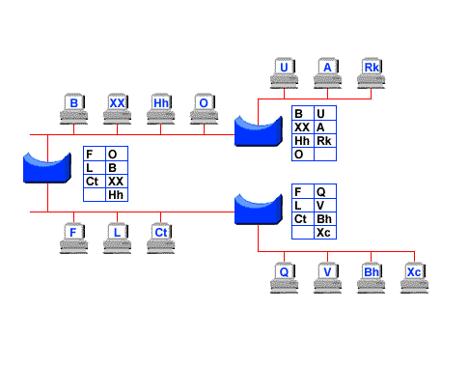
How do bridges filter network traffic?

Slide 26
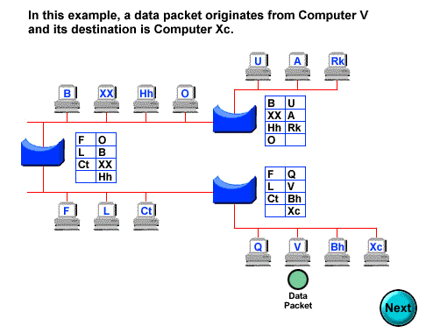

Slide 27
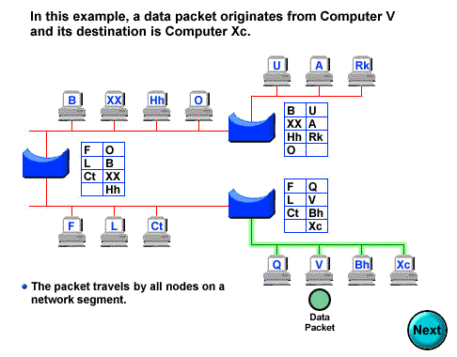

Slide 28
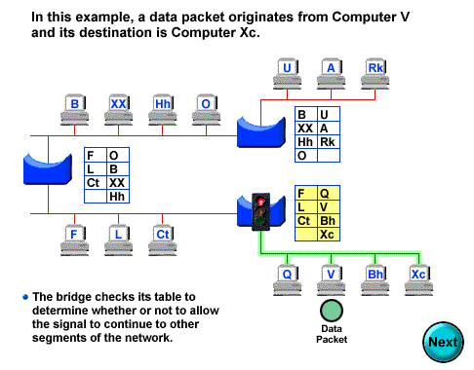

Slide 29
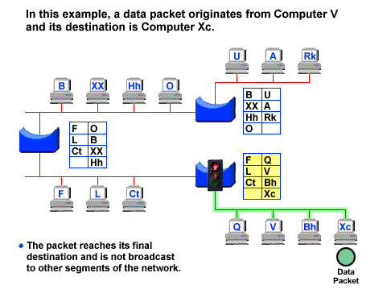

Slide 30


Slide 31
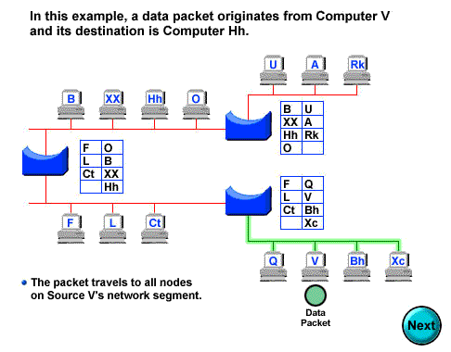

Slide 32
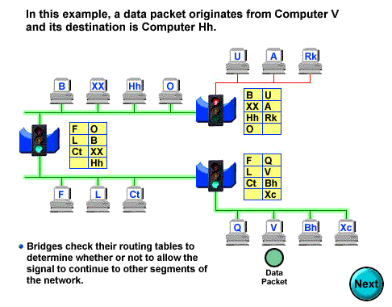

Slide 33
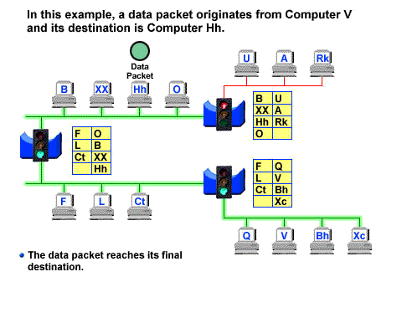

Slide 34
How are bridge data-forwarding decisions limited?
Although bridges use tables to determine whether or not to forward data to other segments of the network, the types of comparisons and decisions they make are relatively low level, simple ones

Slide 35
What types of network traffic problems is a bridge incapable of solving?
Bridges work best where traffic from one segment of a network to other segments is not too great.
However, when traffic between network segments becomes too heavy, the bridge can become a bottleneck and actually slow down communication.

Slide 36
How many addressing schemes are there in networking?
You have already learned what one of these addressing schemes is. It is the MAC address.
The second addressing scheme in networking makes use of what is called the IP address.

Slide 37
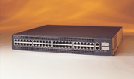
ENG224
INFORMATION TECHNOLOGY – Part I
8. Network Devices
c. Switches
Switches operate at the Data Link layer (layer 2) of the OSI model
Can interpret address information
Switches resemble bridges and can be considered as multiport bridges
By having multiports, can better use limited bandwidth and prove more cost-effective than bridge
Cisco Catalyst 2900 switch

Slide 38
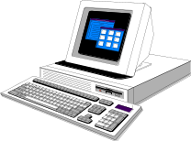
ENG224
INFORMATION TECHNOLOGY – Part I
8. Network Devices
Switches divide a network into several isolated channels
Packets sending from 1 channel will not go to another if not specify
Each channel has its own capacity and need not be shared with other channels
Hub
3.3Mbps
10Mbps
Switch
3.3Mbps
3.3Mbps
10Mbps
10Mbps
10Mbps

Slide 39
ENG224
INFORMATION TECHNOLOGY – Part I
8. Network Devices
Advantages of Switches
Switches divide a network into several isolated channels (or collision domains)
  Reduce the possibility of collision
    Collision only occurs when two devices try to get access to one channel
    Can be solved by buffering one of them for later access
  Each channel has its own network capacity
    Suitable for real-time applications, e.g. video conferencing
  Since isolated, hence secure
    Data will only go to the destination, but not others

Slide 40
ENG224
INFORMATION TECHNOLOGY – Part I
8. Network Devices
Limitations of Switches
Although contains buffers to accommodate bursts of traffic, can become overwhelmed by heavy traffic
  Device cannot detect collision when buffer full
    CSMA/CD scheme will not work since the data channels are isolated, not the case as in Ethernet
  Some higher level protocols do not detect error
    E.g. UDP
  Those data packets are continuously pumped to the switch and introduce more problems

Slide 41
ENG224
INFORMATION TECHNOLOGY – Part I
8. Network Devices
Method of Switching - Cut Through Mode
Preamble
Des. Add
Sour. Add
Length
Data
FCS
7
Bytes
1
Byte
2/6
Bytes
2/6
Bytes
2
Bytes
46 - 1500 Bytes
4
Bytes
Read the first 14 bytes of each packet, then transmit
Much faster
Cannot detect corrupt packets
Can propagate the corrupt packets to the network
Best suited to small workgroups

Slide 42
ENG224
INFORMATION TECHNOLOGY – Part I
8. Network Devices
Method of Switching - Store and Forward Mode
Read the whole packet before transmit
Slower than the cut-through mode
More accurate since corrupt packets can be detected using the FCS
More suit to large LAN since they will not propagate error packets
Facilitate data transfer between segments of different speed
DB
100Mbps
10Mbps

Slide 43
ENG224
INFORMATION TECHNOLOGY – Part I
8. Network Devices
Using Switches to Create VLANs
Switches can logically group together some ports to form a virtual local area network (VLAN)
SW1
VLAN1
VLAN2
Hub
SW2
Hub
Switches can be configured to communicate only within the devices in the group
SW3
Hub

Slide 44
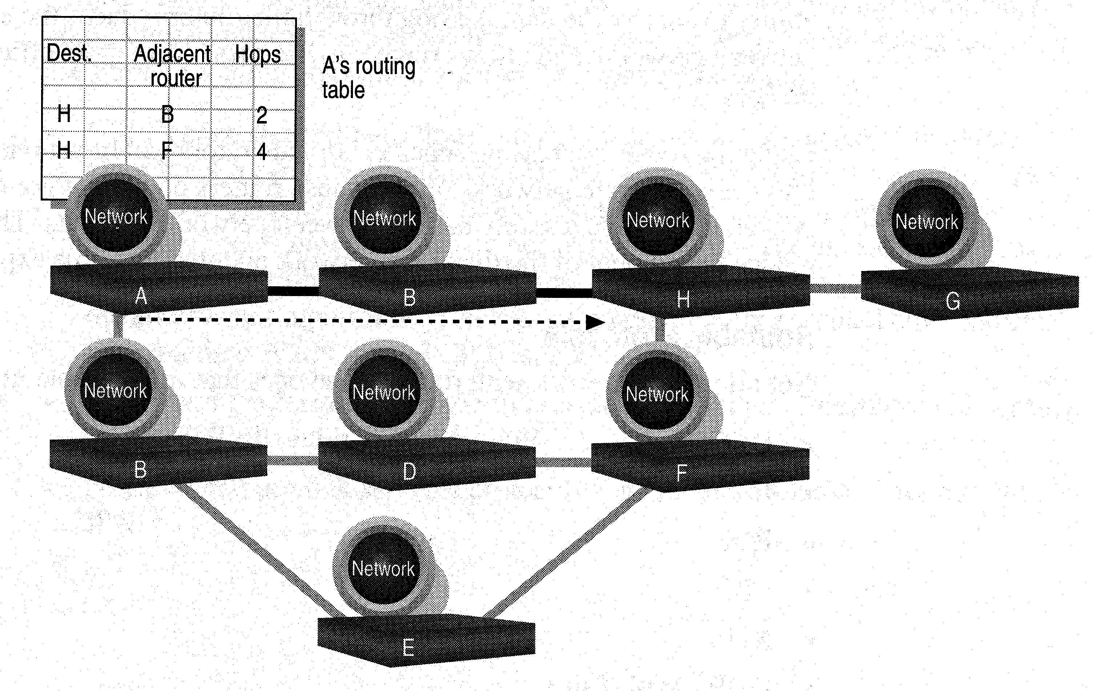
ENG224
INFORMATION TECHNOLOGY – Part I
8. Network Devices
d. Routers
Layer 2 Switches cannot take advantage of multiple paths
Routers work at the OSI layer 3 (network layer)
They use the “logical address” of packets and routing tables to determine the best path for data delivery

Slide 45
What are routers?
Routers are another type of internetworking device.
These devices pass data packets between networks based on network protocol or layer 3 information.
Routers have the ability to make intelligent decisions as to the best path for delivery of data on the network.

Slide 46
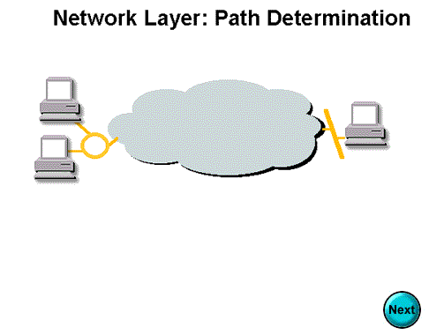

Slide 47
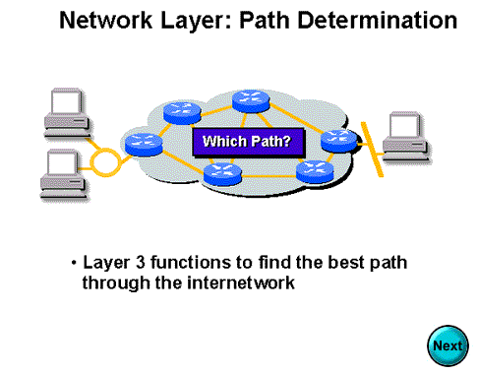

Slide 48
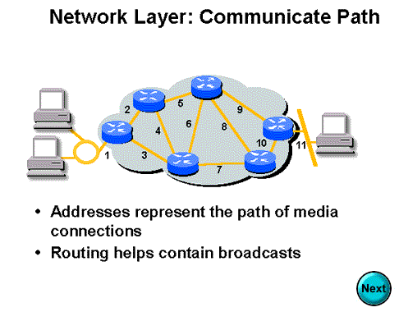

Slide 49
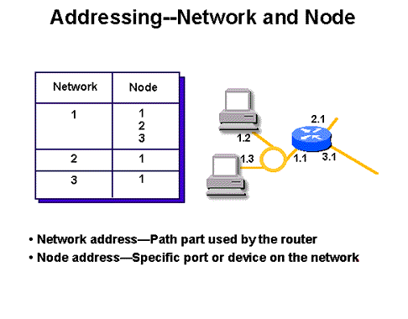

Slide 50
What network problems can routers help resolve?
The problem of excessive broadcast traffic can be solved by using a router.
Routers are able to do this, because they do not forward broadcast frames unless specifically told to do so

Slide 51
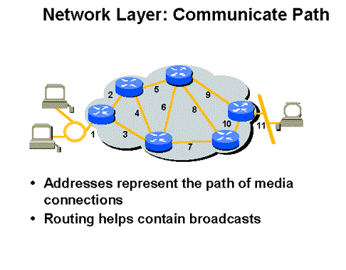

Slide 52
How do routers differ from bridges?
Routers differ from bridges in several respects. First, bridging occurs at the data link layer or layer 2,while routing occurs at the network layer or layer 3 of the OSI model.
Second, bridges use physical or MAC addresses to make data forwarding decisions. Routers use a different addressing scheme that occurs at layer three

Slide 53
How do routers work?
Routers are used to connect two or more networks. For routing to be successful, each network must have a unique network number

Slide 54
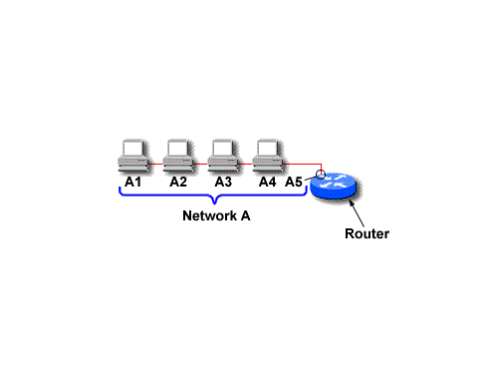
The port where a router connects to network A would have an IP address of A5.

Slide 55
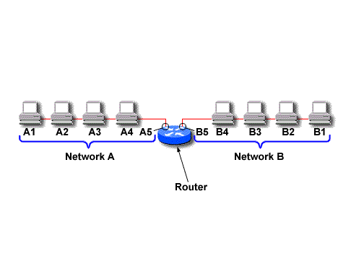
The IP address of the router's second interface would be B5.

Slide 56
ENG224
INFORMATION TECHNOLOGY – Part I
8. Network Devices
How Routers Work
As packets are passed from routers to routers, Data Link layer source and destination addresses are stripped off and then recreated
Enables a router to route a packet from a TCP/IP Ethernet network to a TCP/IP token ring network
Only packets with known network addresses will be passed - hence reduce traffic
Routers can listen to a network and identify its busiest part
Will select the most cost effective path for transmitting packets

Slide 57
ENG224
INFORMATION TECHNOLOGY – Part I
8. Network Devices
How Routing Table is formed
Routing table is formed based on communications between routers using “Routing Protocols”
  Routing Protocols ≠ Routable Protocol
Routing Protocols collect data about current network status and contribute to selection of the best path
Routers communicate within themselves

Slide 58
ENG224
INFORMATION TECHNOLOGY – Part I
8. Network Devices
Routing Protocol Example - RIP for IP Routing
RIP (Routing Information Protocol) ― the oldest one
Use no. of hops between nodes to determine best path
Does not consider the network congestion condition
Broadcast every 30 sec the routing table to neighbouring routers to convey routing information
RIP is limited to interpreting a maximum of 16 hops
Not suitable for large network (e.g. Internet)
Can create excessive network traffic due to broadcasting
May take a long time to reach the far reaches

Slide 59
ENG224
INFORMATION TECHNOLOGY – Part I
8. Network Devices
Routing Protocol Example - OSPF for IP
OSPF - Open Shortest Path First
Make up the limitations of RIP - can coexist with RIP
In general case, best path refers to the shortest path
In case of traffic congestion, can go a longer path
Each router maintains a database of other router’s links
If link failure notice is received, router can rapidly compute an alternate path
Require more memory and CPU power

Slide 60
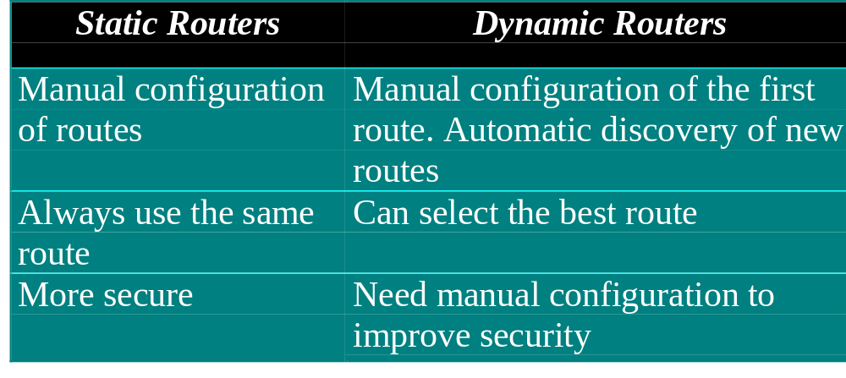
ENG224
INFORMATION TECHNOLOGY – Part I
8. Network Devices
Static and Dynamic Routers

Slide 61
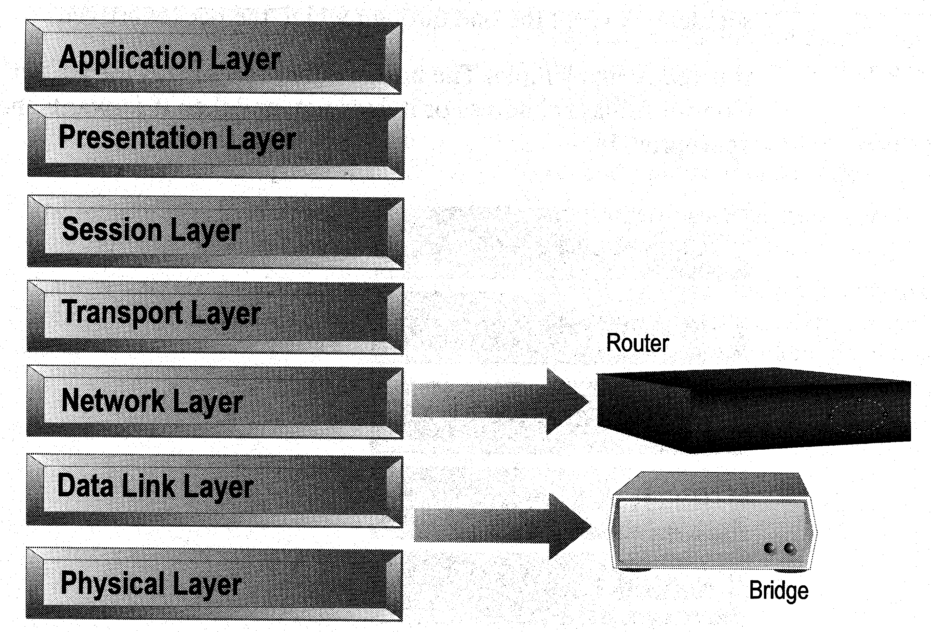
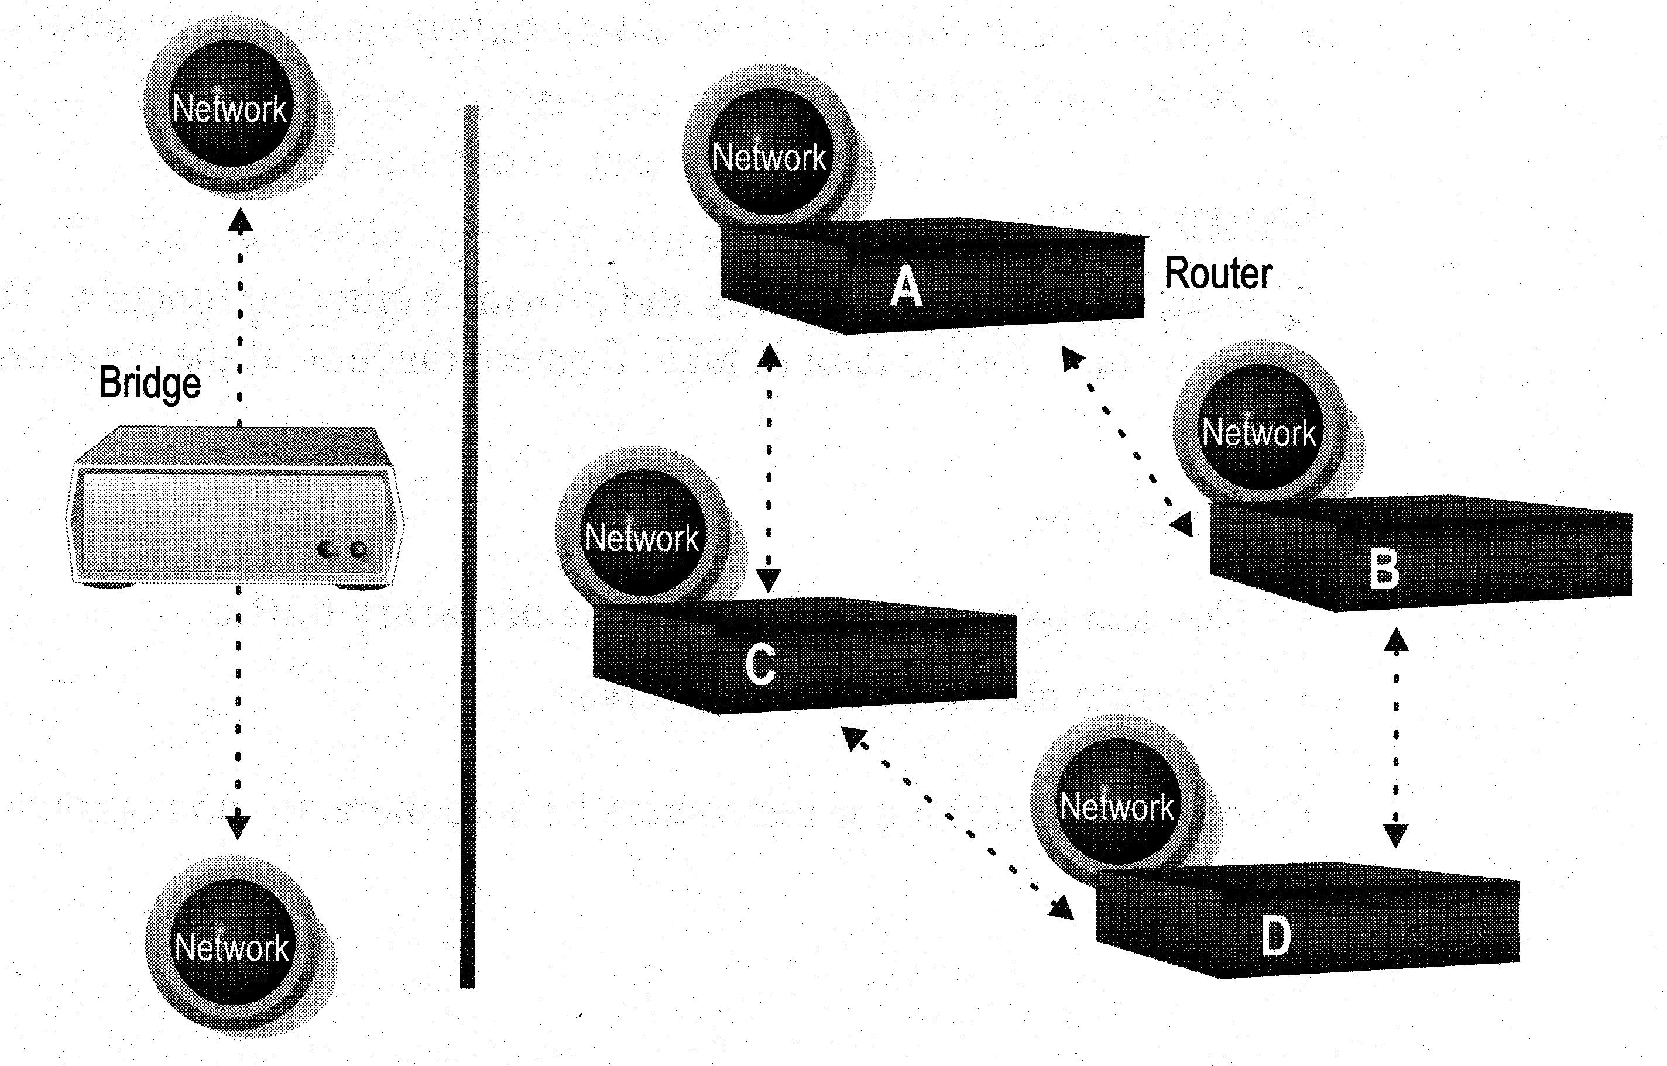
ENG224
INFORMATION TECHNOLOGY – Part I
8. Network Devices
Distinguishing Between Bridges and Routers
Bridges forward everything they don’t recognize
Routers select the best path
Routers are layer 3 devices which recognize network address
Bridges are layer 2 devices which look at the MAC sublayer node address

Slide 62
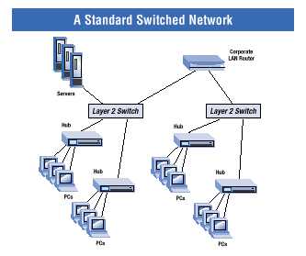
ENG224
INFORMATION TECHNOLOGY – Part I
8. Network Devices
Layer-3 Switches
Layer-3 switches operate in both layer 2 (data link layer) and 3 (network layer)
Can perform both MAC switching and IP routing
A combination of switch and router but much faster and easier to configure than router
Why Layer-3 switches?
Traffic of LAN is no longer local
Speed of LAN is much faster
Need a much faster router, however, very expensive
Excerpt from www.intel.com

Slide 63
ENG224
INFORMATION TECHNOLOGY – Part I
8. Network Devices
Summary
Repeaters are the least expensive way to expand a network, but they are limited to connecting two segments
Bridges function similar to repeaters, but can understand the node addresses
Switches can be considered as multiport bridges, can divide a network into some logical channels
Routers interconnect networks and provide filtering functions. They can determine the best route

Slide 64
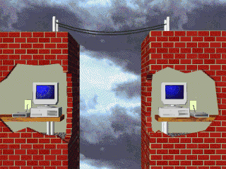
ENG224
INFORMATION TECHNOLOGY – Part I
8. Network Devices
B. Remote Access Devices
1. Modems
Allow computers to communicate over a telephone line
Enable communication between networks or connecting to the world beyond the LAN

Slide 65
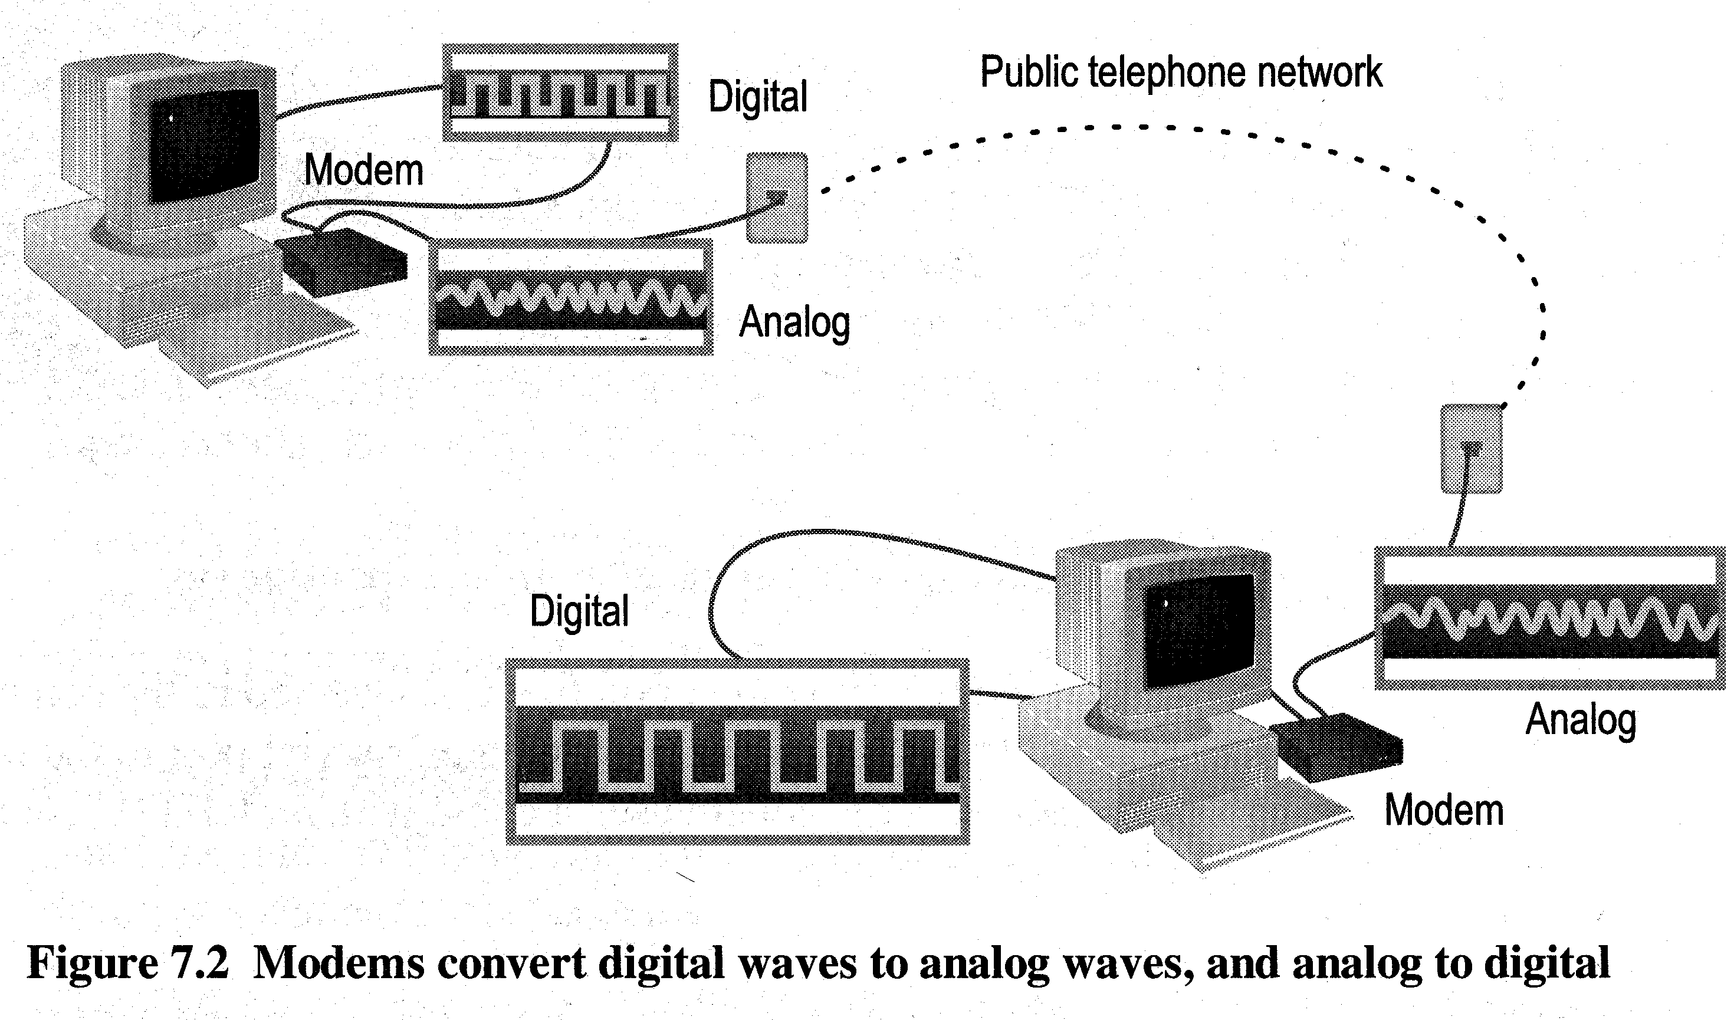
ENG224
INFORMATION TECHNOLOGY – Part I
8. Network Devices
Cannot send digital signal directly to telephone line
Sending end: MODulate the computer’s digital signal into analog signal and transmits
Receiving end: DEModulate the analog signal back into digital form

Slide 66
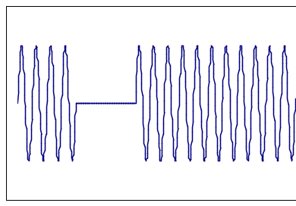
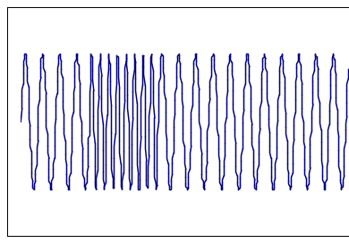
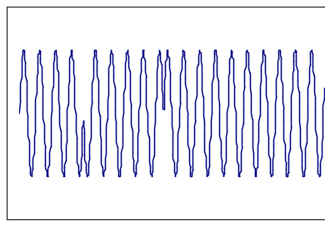
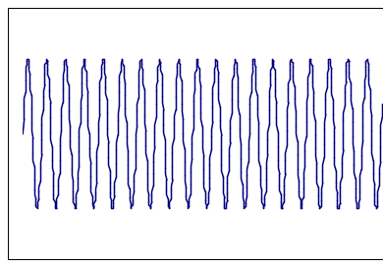
ENG224
INFORMATION TECHNOLOGY – Part I
8. Network Devices
1
0
1
1
1
Amplitude Modulation
Frequency Modulation
Phase Modulation
Normal sine wave

